Slide 1
Project Presentation of CO-OP Project at Industry (Module-2) (22CS421)
On
AI-Driven Demand Forecasting Model for Micro-Retailers Using Machine Learning
Ayush — 2210991415
Diya — 2210991543
Supervised By
Dr. Simarjit Kaur
Department of Computer Science and Engineering,
Chitkara University, Punjab

Slide 2
Introduction
Demand forecasting estimates future customer demand using historical sales, trends, and external factors — critical for inventory, supply chain, and pricing decisions.
In India, micro-retailers (kirana stores) form the backbone of unorganized retail but operate without formal records, relying on intuition for purchasing decisions.
Limited resources, low technical expertise, and irregular demand patterns lead to overstocking, stockouts, and lost profits.
With UPI and digital billing adoption, transactional data is now increasingly available — opening the door to AI-driven forecasting for small retailers.
This project proposes an end-to-end AI-based demand forecasting framework tailored for the micro-retail environment.
2

Slide 3
Objectives
Develop a short-term demand prediction framework specifically designed for micro-retail (kirana) stores.
Compare classical statistical, classical ML, and deep learning models — ARIMA, Random Forest, and LSTM — under realistic data conditions.
Engineer features that capture seasonality, festivals, weekly cycles, and lag-based demand signals.
Address practical challenges of data scarcity, sparse demand, and cold-start problems for new SKUs.
Quantify forecasting improvement using MAE, RMSE, and MAPE against current intuition-based baselines.
Demonstrate that data-driven inventory intelligence is feasible for small retailers, not just large chains.
2

Slide 4
Literature Review
Classical methods (Exponential Smoothing, ARIMA) work well for stable, low-noise time series but assume linearity — limiting use in volatile retail [Box et al., Hyndman].
Tree-based ML (Random Forest, XGBoost) handles non-linear relations and rich features, often outperforming statistical baselines [Fildes et al., Chen & Guestrin].
LSTM networks (Hochreiter & Schmidhuber, 1997) overcome the vanishing-gradient problem of RNNs and excel at long-range temporal dependencies in sales data.
Forecasting in informal/micro-retail settings is under-studied; data is sparse, intermittent, and SKU-heterogeneous [Rajaram & Tang; Boylan & Syntetos].
UPI and digital billing in India now provide a usable data foundation for kirana-store analytics [Narayanan & Gulati].
Transfer learning helps the cold-start problem by reusing knowledge from high-frequency SKUs [Huang et al., 2022].
2

Slide 5
Proposed Methodology
An end-to-end four-stage pipeline tailored for the micro-retail environment.
Stage 1 — Data Collection & Preprocessing: ingest raw UPI / digital billing logs; handle missing values, deduplication, and aggregation.
Stage 2 — Feature Engineering: build temporal, lag, festival, and seasonality features from cleaned sales data.
Stage 3 — Model Training & Selection: train ARIMA, Random Forest, and LSTM in parallel; evaluate using rolling-window cross-validation.
Stage 4 — Inference & Business Output: generate 7-day-ahead demand forecasts to drive inventory ordering decisions.
Pipeline flow: Raw Sales Data → Preprocessing → Feature Engineering → Model Training → Demand Forecast
2

Slide 6
Data Collection & Preprocessing
Source: digital billing and UPI transaction logs from five kirana stores in Punjab, India.
Missing-value handling: zero-fill for confirmed no-sale days; mean substitution for system-outage gaps.
Duplicate and irrelevant entries are removed to maintain data reliability.
Aggregation at daily granularity (preserves intra-week patterns) and weekly granularity (reduces noise for slow-moving SKUs).
Min-max normalisation scales all features to the [0, 1] range to prevent large-valued variables from dominating model training.
2

Slide 7
Feature Engineering
Lag features: historical sales at 1-day, 7-day, and 14-day lags capture autoregressive demand signals.
Temporal features: day-of-week (cyclic sine–cosine encoding), week-of-month, and month-of-year capture periodic purchasing patterns.
Festival indicators: binary flags for Diwali, Holi, Eid, Christmas, public holidays, and local events.
Seasonality index: derived using Fourier decomposition of the training set to capture annual cycles.
Cold-start proxy: category-level sales aggregates serve as features for new SKUs until enough product-level history accumulates.
2

Slide 8
Model Architectures
ARIMA (statistical baseline) — order (p, d, q) selected automatically per SKU using the Akaike Information Criterion (AIC).
Random Forest Regressor (classical ML baseline) — 300 estimators, maximum depth of 15, trained on the full engineered feature set.
LSTM (proposed deep learning model) — two stacked LSTM layers (64 and 32 units), Dense output layer with linear activation.
LSTM training: Adam optimiser, learning rate 0.001, batch size 32, 100 epochs with early stopping on validation loss.
Cold-start strategy: category-level proxy forecasts for SKUs under 30 days; transfer learning by initialising LSTM weights from a high-frequency SKU model and fine-tuning.
Data split: 70% training, 15% validation, 15% test — held-out, time-ordered.
Hyperparameter tuning: ARIMA via per-SKU AIC minimisation; Random Forest via randomised search (50 iterations); LSTM via Bayesian optimisation (30 trials).
2

Slide 9
Experimental Setup & Dataset
Dataset span: 18 months of daily sales records from five kirana stores (urban and peri-urban Punjab).
Coverage: 312 unique SKUs across 7 categories — groceries, dairy, beverages, personal care, household goods, snacks, staples.
Volume: ~1.2 million transaction records after deduplication and cleaning.
Period includes Diwali 2022 and Holi 2023 festival seasons — enables evaluation under demand-spike conditions.
Hardware: Intel Core i7-12700, 32 GB RAM; LSTM accelerated on NVIDIA RTX 3060 GPU.
Stack: Python 3.10, scikit-learn 1.3 (RF), statsmodels 0.14 (ARIMA), TensorFlow 2.12 / Keras (LSTM).
Validation: rolling-window cross-validation, 90-day window, 7-day forecast horizon.
Evaluation Metrics: MAE = (1/n) Σ |yᵢ − ŷᵢ| • RMSE = √[ (1/n) Σ (yᵢ − ŷᵢ)² ] • MAPE = (100/n) Σ |(yᵢ − ŷᵢ) / yᵢ|
2

Slide 10
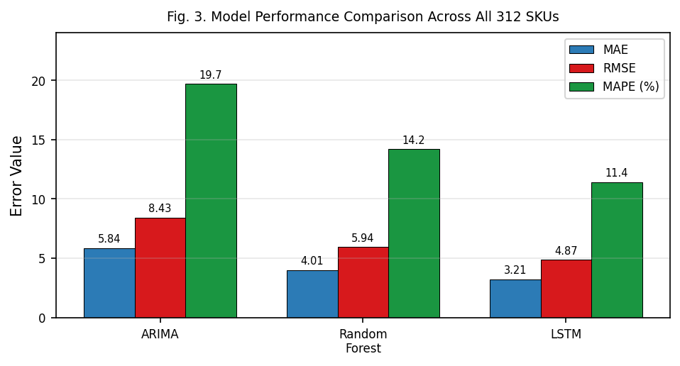
Results — Overall Performance
Evaluation metrics: MAE, RMSE, and MAPE — averaged across all 312 SKUs over the full 18-month period.
ARIMA: MAE = 5.84, RMSE = 8.43, MAPE = 19.7% (statistical baseline).
Random Forest: MAE = 4.01, RMSE = 5.94, MAPE = 14.2% (engineered features help significantly).
LSTM (Proposed): MAE = 3.21, RMSE = 4.87, MAPE = 11.4% — best across all three metrics.
LSTM reduces forecasting error by 18–25% vs ARIMA and 10–14% vs Random Forest.
Compared to the retailer's intuition-based baseline (~32% MAPE), even ARIMA improves accuracy substantially; LSTM nearly triples it.
Fig. 3. Model Performance Comparison Across All 312 SKUs.
2

Slide 11
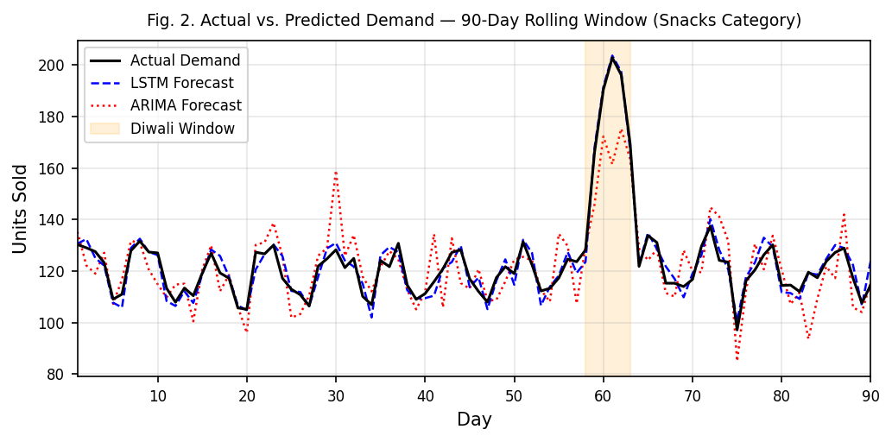
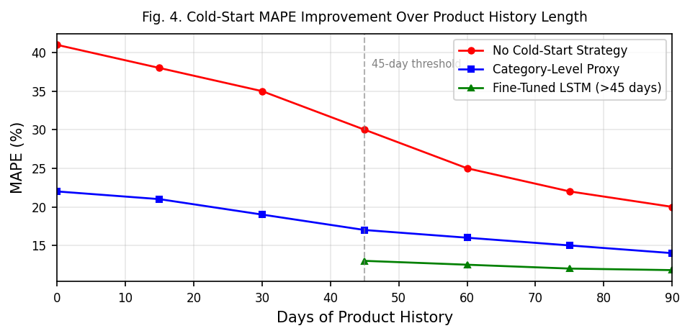
Results — Festivals & Cold-Start
Festival window (Diwali 2022, 5 days): demand spikes of 2.5x–4.2x baseline observed across snacks, beverages, and gift items.
Diwali 5-day window — model comparison (Table II):
ARIMA — MAE 9.12 | RMSE 13.47 | MAPE 28.3%
Random Forest — MAE 6.34 | RMSE 9.11 | MAPE 18.6%
LSTM — MAE 4.38 | RMSE 6.42 | MAPE 13.1% (best; RMSE 31% < ARIMA, 17% < RF)
LSTM tracks festival spikes with notably lower lag, attributed to multi-step temporal context and binary festival indicators.
Cold-start problem (new SKUs, <30 days history): unconstrained model MAPE ≈ 41%; category-level proxy reduces it to 22%.
After 45 days of history, fine-tuned LSTM achieves MAPE = 11.8% — close to mature high-frequency SKU performance.
On non-festival weeks, LSTM and Random Forest perform comparably (9–13% MAPE); RF is a viable lighter-weight alternative.
Fig. 2. Actual vs. Predicted Demand — 90-Day Rolling Window (Snacks).
Fig. 4. Cold-Start MAPE Improvement Over Product History Length.
2

Slide 12
Conclusion & Future Work
Demonstrated that AI-based demand forecasting is feasible and beneficial for India's micro-retail (kirana) sector.
LSTM consistently outperforms ARIMA and Random Forest, with the largest gains during festival-driven demand spikes.
Random Forest is a practical alternative when GPU/deep-learning infrastructure is unavailable.
Cold-start mitigation via category-level proxies and transfer learning makes the framework deployable for new SKUs.
Real impact: reduced stockouts, lower excess inventory cost, and better working-capital utilization for small retailers.
Future work — integrate weather and social-media signals; build a lightweight mobile inference app for kirana owners; extend to multi-store collaborative forecasting.
2

Slide 13
Thank You
3

